Slide 1
Health Vocabulary
Intermediate 03

Slide 2
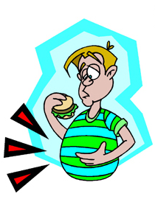
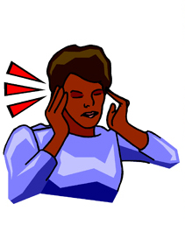
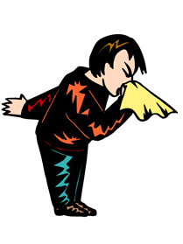

PROBLEMS
headache
stomach-ache
earache
sneeze

Slide 3


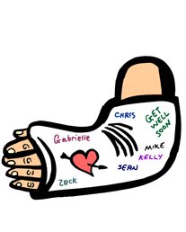

MORE PROBLEMS
Injured elbow
Broken arm
fever

Slide 4



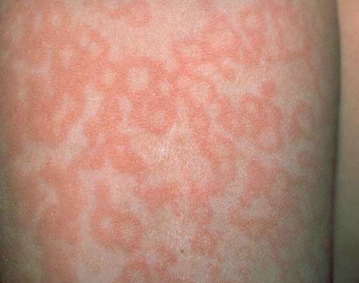
MORE PROBLEMS
rash
broken nose
cough

Slide 5



MORE PROBLEMS
Runny nose
cut
broken finger

Slide 6
Useful expressions: Buying medicine
Have you got anything for…?
Is it for yourself?
How often?
You need to take / use it...
Once a day
Every four hours
Twice a day
Three times a day

Slide 7




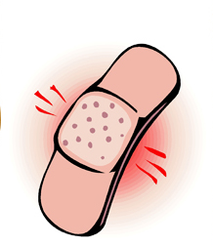
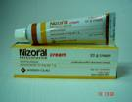
MEDICINE
tablets
Shot /
Injection
drops
syrup
syringe
needle
bandage
cream

Slide 8



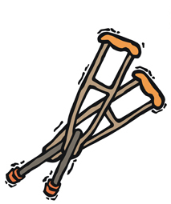
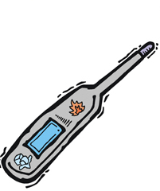
MEDICAL TOOLS
hospital
scales
wheelchair
crutches
thermometer

Slide 9




MEDICAL TOOLS
surgeon
hospital
doctor
female nurse
male nurse

Slide 10






Practice: Match the problems with the treatments
Problem | Medicine | How often?
 |  | Once a day Every four hours Twice a day Three times a day Every six hours Every eight hours
Example: She has a headache she needs to take a tablet every six hours

Slide 11
Practice: Make 3 conversations at the chemist’s
Hello, Can I help you?
Yes. Have you got anything for a ?
Is it for you?
Yes, it is
Well these are very good.
How often do I have to take them?
You can take them _____. Is there anything else/any other symptoms?
I can’t stop/have/feel/..hurt. What can you prescribe me for that?
Well these______ ...
Thank you

Slide 12
Practice: Make 3 conversations at the Doctor’s
Hello, Can I help you?
Hi Doctor, yes I don’t feel very well.
Please tell me what are the symptoms?
Well, I have/feel/can’t stop/...hurt
Is there anything else?
Yes, __________________
Well these ____________are very good for the____.
How often ?
You can take them ___________
Thank you

